Slide 1
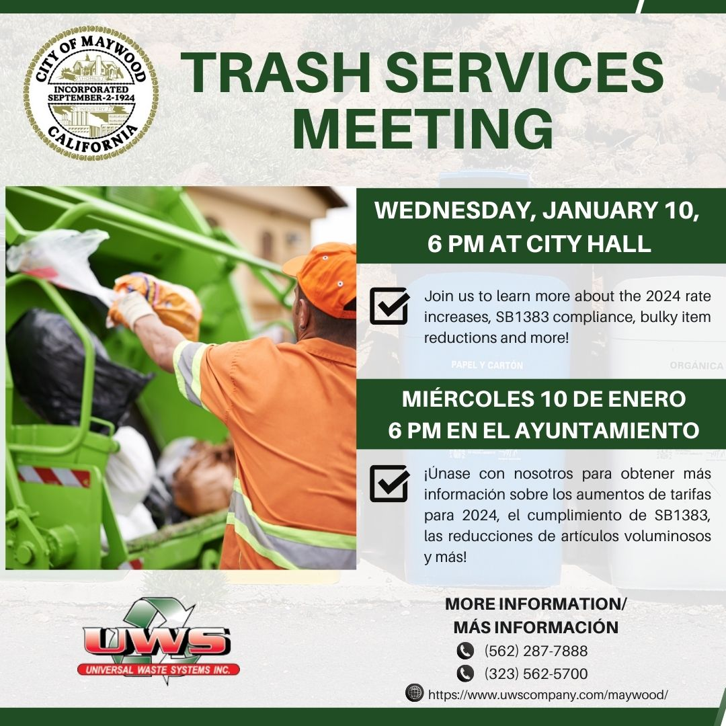

Large Enough to Serve, Small Enough to Care!

Slide 2
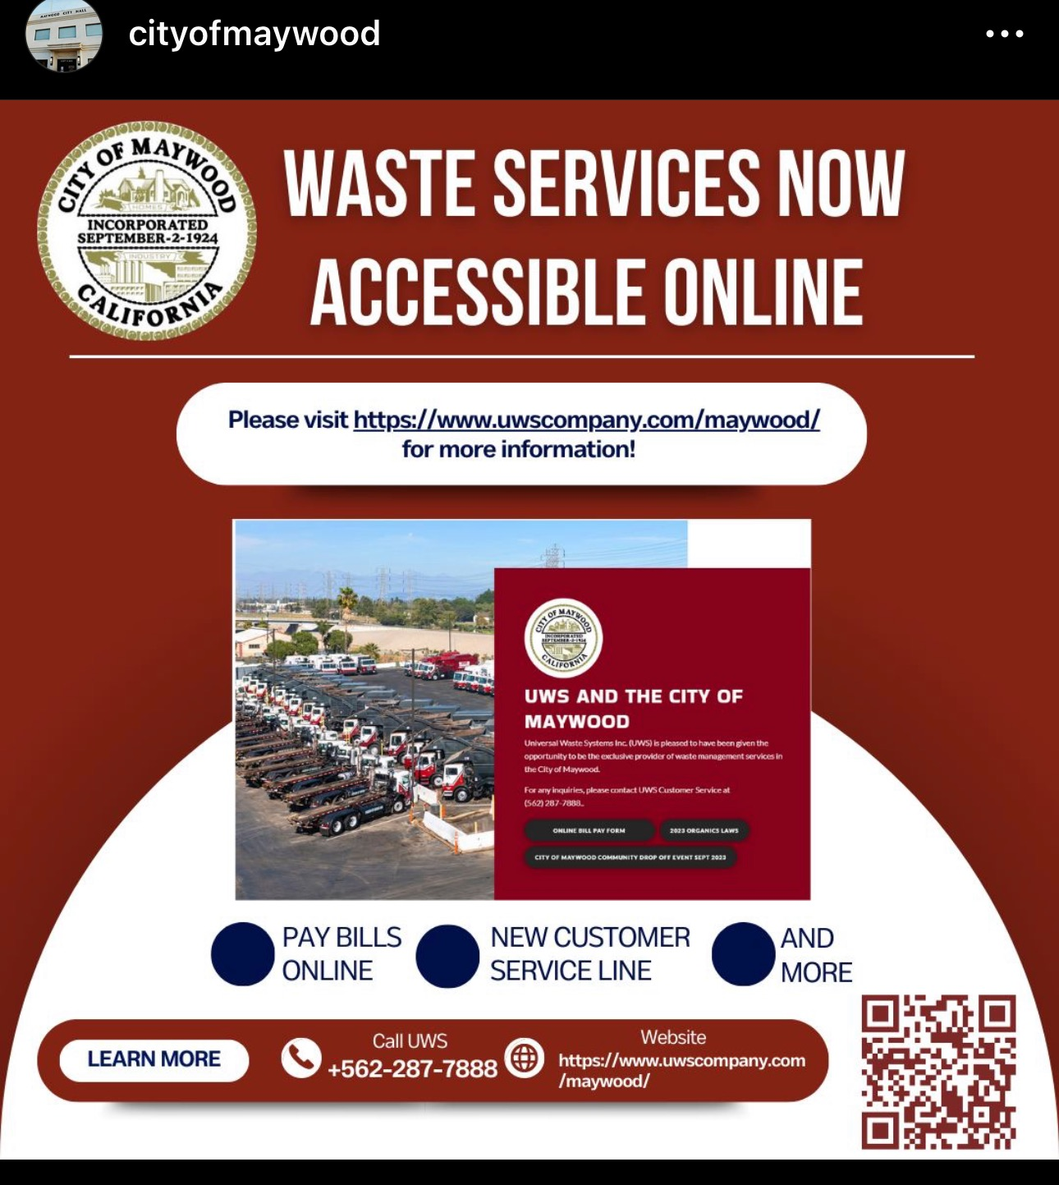
Maywood Custom Website

Slide 3
Benefits to the Community
Helps meet the State waste reduction mandates Assembly Bill 939 and Senate Bill 1383
Provides for NEW Organic Waste Recycling Programs
Provides high-quality Customer Service
Provides accountability based on field monitoring activities
Preserves the environment and promotes a cleaner neighborhood
Maintains alley ways and public streets throughout the community

Slide 4
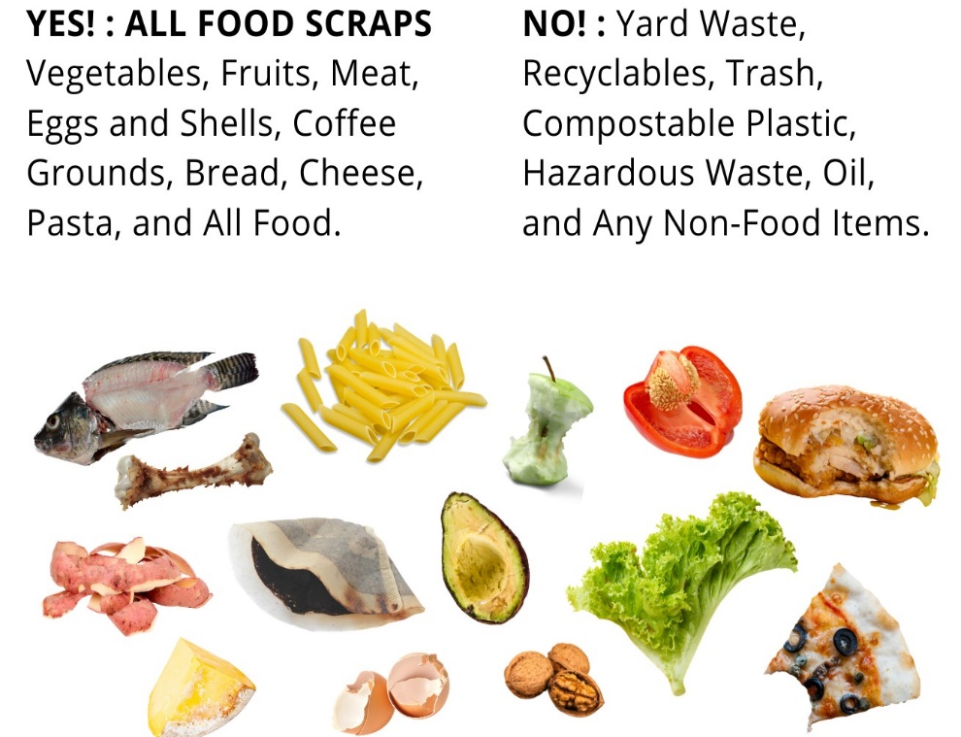
Senate Bill 1383
Organic Waste Reduction
  Requires 75% reduction of organic waste to the landfill by 2025
  Regulations require recovery of excess edible food
  New requirements were effective January 1, 2022
  State enforcement begins January 2024
YES! : ALL FOOD SCRAPS
Vegetables, Fruits, Meat, Eggs and Shells, Coffee Grounds, Bread, Cheese, Pasta, and All Food.
NO! : Recyclables, Trash, Compostable Plastic, Hazardous Waste, Oil, Gloves, Stickers, Ties, Food Packaging and All Non-Food Items.

Slide 5
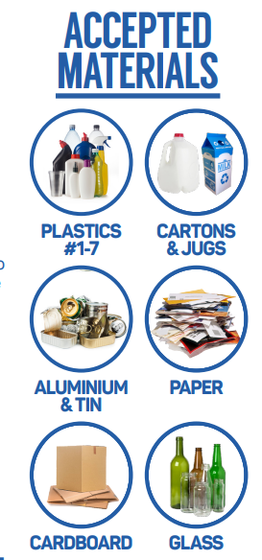
AB 341 RECYCLING
  State law that requires all customers to separate recyclable material from their waste stream.
  All Maywood customers are required to have a blue barrel for recycling.
  If you would like to learn more about recycling please call (562) 287-7888

Slide 6
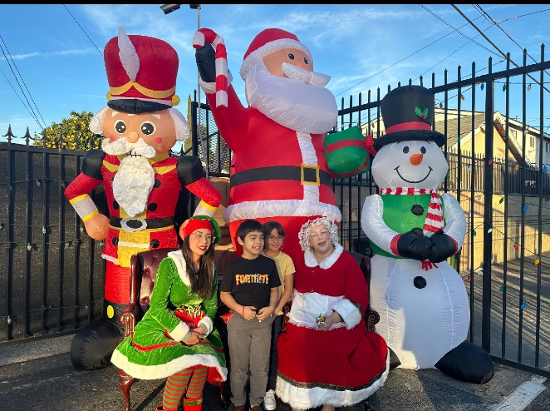
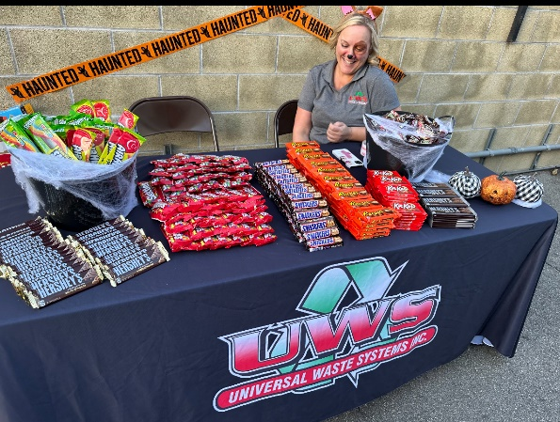
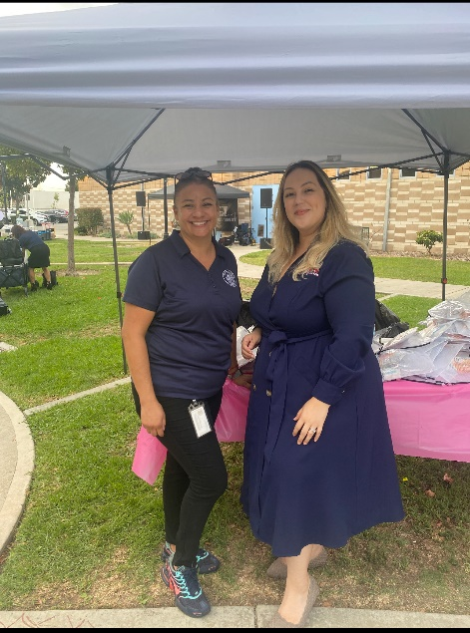
Events UWS donated & participated
Trunk or Treat
Turkey Drive
Christmas Tree lighting
Toy and Food Drive
Backpack giveaway
Scholarship Program

Slide 7
Services Completed between 2021-2023
No. of carts and bins tipped:
Commercial – 107,414
Multi-Family – 143,280
Residential – 1,968,829
Bulky Items Collected:
Commercial – 20 requests, 41 items collected
Multi-Family – 379 requests, 1,007 items collected
Residential – 4501 requests, 12,595 items collected
No. of Illegal Items Collected:
475 requests, 490 items collected

Slide 8
Annual Rate Increase
Effective January 1, rates are increased by CPI in accordance with the contract. For more information please contact UWS customer service.
New Single Family Residential Rate: From $26.31 to $26.63
New Single Family Residential Senior Citizen Rate: From $21.39 to $21.74
Commercial Rate for Standard Service: 1 yard 1 time per week: From $160.42 to $164.38
Commercial Rate for Standard Service: 3 yard 1 time per week: From $213.77 to $219.05
For a complete list of updated rates please contact
customer service at (562) 287-7888.

Slide 9
Programs and Events
Quarterly Bulky Item Drop off Events
Sharps Collection Program
Mulch / Compost Giveaway Program
Shredding Events
Bulky Item Collection:
Single Family/Multi-Family are entitled to four (4) bulky waste pickups per dwelling unit, per year and up to six (6) items per pick up
Weekly Abandoned Item Sweeps & Collection
E-Waste/Covered Electronic Devices collection

Slide 10
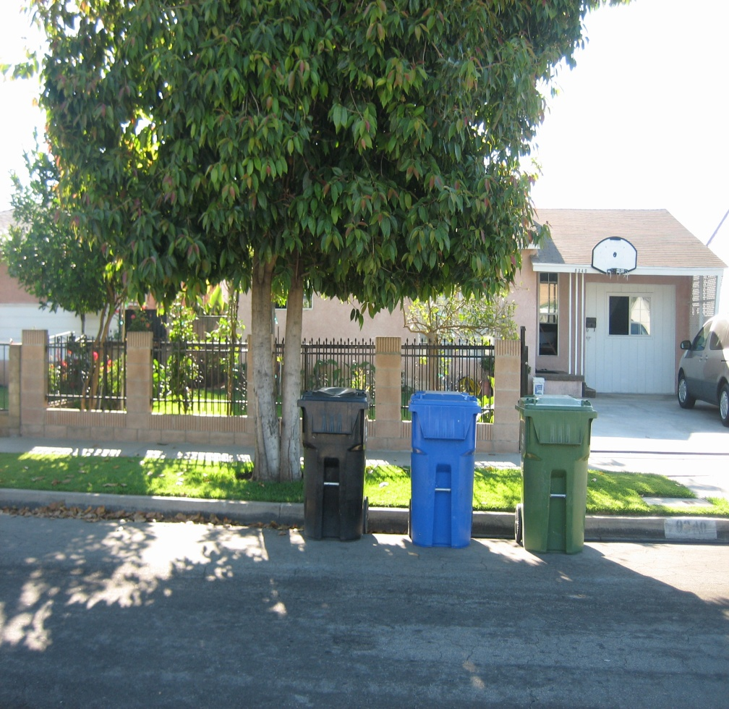
Where should I place my carts?
Place your 3 carts on the street closest to the curb at least 18” apart from each other the night before your collection day or the day of by 6 a.m.
Collection vehicles will pass by to collect each container at different times on your collection day

Slide 11
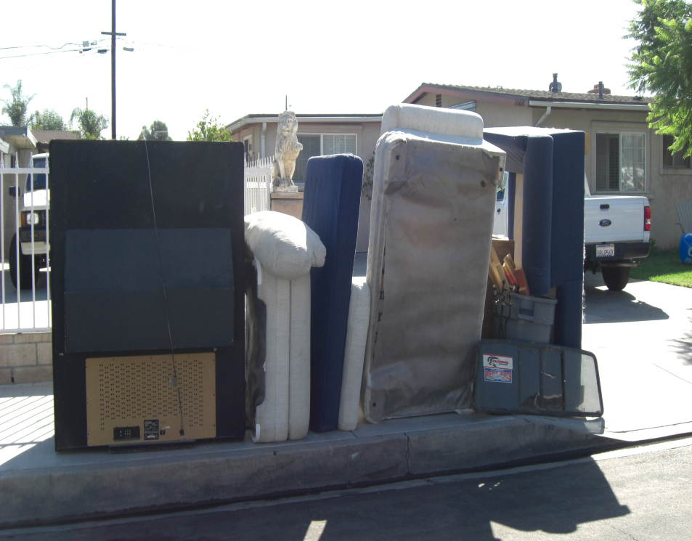
Bulky Items and Missed Pick-ups
You can schedule a bulky item pick-up by calling the UWS customer service line to set up an appointment prior to collection. You may also download the City of Maywood's “connectmaywood” app to report your bulky item pick-up.
Bulky items and E-waste should be placed out on the curb after an appointment date is set up. You must place your bulky items and e-waste on the curb 24 hours in advance of collection day.
Do not place bulky Items or e-waste out on the curb until an appointment is scheduled. Bulky items that are set out and not reported can lead to code enforcement action.
Missed pick-ups - If your trash is not picked-up contact UWS at (562) 287-7888.

Slide 12

Hazardous Waste: Too TOXIC to TRASH
No Paint
No Batteries
No Car Parts
No Flammable Liquids
No Household Cleaners
No Engine Coolant
No Pesticides
No Used Oil
Los Angeles County offers FREE Household Hazardous Waste events. To find a location near you, please call (888) CLEAN-LA or visit cleanla.com.

Slide 13






Holiday Schedule
Universal Waste Systems Inc. observes the following holidays:
Memorial Day
4th of July
Labor Day
Thanksgiving
Christmas Day
New Years Day
If the holiday falls on a weekday, collections for the remainder of the week will be delayed by one day.

Slide 14
Questions / Comments
Universal Waste Systems Inc Customer Service Office Hours
Monday – Friday 8 a.m. to 5 p.m.
Universal Waste Systems Inc.
9010 Norwalk Blvd, Santa Fe Springs CA 90670
(562) 287-7888
Together we make a difference.

